Slide 1



Maternal Diet and Fetal Growth in a Pregnancy Cohort
Marie O’Neill
February 8, 2018
With thanks to Drs. Melissa Smarr, Monica Ancira-Moreno, Marisol Castillo-Castrejon and Miatta Buxton
for slides and other background

Slide 2
Low Birth Weight
birthweight <2,500 grams
< 37 weeks completed gestation
a condition in which a fetus does not achieve optimal growth
Preterm Birth
(PTB)
Intrauterine Growth Restriction
(IUGR)
Average Growth
Term Birth
Notes:
In perinatal epidemiology low birth weight serves as a common indicator of poor fetal health.
According to the WHO, globally there are more than 20 million infants that have globally been identified as LBW. The 2 primary etiologies of low birth weight are being born preterm ( less than 37 weeks of gestation) and being growth restricted.
However it is important to mention that not all preterm births are growth restricted and vice versa.
The focus on this dissertation research is placed on IUGR as the health endpoint.
Which is a concept signifying that a fetus has not achieved optimal growth while in the womb.

Slide 3

IUGR Related Neonatal Morbidity & Mortality
Causal factor in 50% of stillbirths (Figueras et al, 2011)
2nd leading cause of prenatal morbidity & mortality (Peleg et al, 1998)
Fetal mortality is 50% higher than neonatal mortality
Higher rates in males than females
Neurological and mental development
Cerebral palsy (Illa et al, 2009)
ADHD (Bertino et al, 1996)
Courtesy of Dr. Felipe Vadillo
Notes:
For the growth restricted fetus, survival and quality of life is of great concern. IUGR is a causal factor in 50% of reported stillbirths and reported to be the 2nd leading cause of prenatal mortality and morbidity.
There are gender differences in IUGR attributed mortality , with rates being higher among males
And in early childhood, IUGR has been associated with adverse neurological and mental development

Slide 4
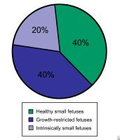
Fetal Growth Restriction
Assessment in utero:
Intrauterine growth restriction (IUGR)
Small size and reductions in growth rate of anthropometric parameters
Ratios of anthropometric parameters
Estimated fetal weight < 10th percentile
Distinguish between symmetric vs asymmetric IUGR
Increased morbidity and mortality
IUGR ≠ SGA
Assessment at birth:
Small for gestational age (SGA)
Weight <10th percentile of age and sex adjusted population curves
comparisons of anthropometric parameters with population curves
Most SGA are constitutionally small
No increased morbidity or mortality
Healthy small fetuses
Growth restricted fetuses
Intrinsically small fetuses
Adapted from Ross et al , 2013. http://emedicine.medscape.com/article/261226-overview
Notes:
Fetal growth restriction can be assessed at two time periods, the first being more common in clinical settings which is in utero assessment. Here restricted growth is identified by stalled changes in size and reductions in rate of growth of various anthropometric parameters and even estimated fetal weight less than the 10th percentile of population curves.
With in utero assessment it is also
The second assessment time period is at birth, which is common for epidemiological studies. Where an infant is identified as growth restricted if their birth weight is less than the 10th percentile of the age and sex adjusted population weight curves.
However, Most SGA cases not growth restricted but are constitutionally small…meaning that they are smaller than average but there is no supporting pathological explanation
This pie chart shows the breakdown of small fetuses, and as you can see, only 20 % is related to some intrinsic factor like a chromosomal abnormality, leaving half of the remaining 80% to be explained by some pathological or extrinsic factor, and the others to be small but healthy fetuses with no increased risk of morbidity or mortality.

Slide 5
Limitations on use of birth weight
Birth weight is not a good proxy for restriction occurring in 1st and 2nd trimesters (Hemachandra et al. 2006)
Intrauterine growth restriction (IUGR) ≠ SGA (Kingdom and Baker , 2000)
Constitutional vs Pathological growth restriction (Ananth and Vintzileos, 2009) (asymmetrical growth)
Use of serial ultrasound measurements may help to better identify IUGR (Carrera, JM. 2001; Woodruff et al . 2009)
Notes:
Some of the motivation behind this research includes the fact that air pollution and adverse birth outcomes has been studied at great lengths. But that for most of these studies fetal growth was assessed at birth with the use of the previously explained SGA measure.
However, if the Effect of air pollution on fetal growth may result in a hindrance at one time period but the fetus is able to catch up in growth at later time period, then weight assessed at birth may not be a good proxy for IUGR.
Therefore it has been suggested by an international air pollution and reproductive health work group, that the use of serial ultrasound measurements may help to better identify reductions in fetal growth in epidemiological studies.

Slide 6

Extrinsic Risk Factors for IUGR
Health (weight, medical history), behaviors (smoking, alcohol consumption, nutritional status)
Environmental tobacco smoke, air pollutants, altitude, etc.
Placenta size, villous structure, uterine blood flow, lack of nutrients
Images(Top to Bottom): Insidesocial.com, hispanicallyspeakingnews.com, Pnas.org,www.m.more4kids.com
Notes:
So what are these Extrinsic Risk factors of IUGR? They are typically described as maternal factors including health and lifestyle behaviors. Environmental factors like high altitude and air pollutants, and placental factors like placenta size and uterine blood flow. As you can tell by the way they are presented here, these are not always isolated factors and changes in one category may definitely effect changes in another.

Slide 7
Maternal diet and IUGR reviews
Abu-Saad K, Fraser D. Maternal Nutrition and Birth Outcomes. Epidemiol Rev. 2010;32(1):5-25.
Gresham E, Byles JE, Bisquera A, Hure AJ. Effects of dietary interventions on neonatal and infant outcomes: a systematic review and meta-analysis. The American Journal of Clinical Nutrition. 2014;100(5):1298-321.
Chen X, Zhao D, Mao X, Xia Y, Baker NP, Zhang H. Maternal Dietary Patterns and Pregnancy Outcome. Nutrients. 2016;8(6).
Grieger AJ, Clifton LV. A Review of the Impact of Dietary Intakes in Human Pregnancy on Infant Birthweight. Nutrients. 2015;7(1).

Slide 8
‘Good’ diet supports fetal growth
“Maternal nutrition is a modifiable risk factor of public health importance that can be integrated into efforts to prevent adverse birth outcomes.” (Abu-Saad et al 2010)
“All dietary interventions and those focused on macronutrient intake also increased birth weight (P 0.01) and length (P 0.05) and reduced the incidence of low birth weight (P 0.01).” (Gresham et al 2014)
Observational studies and randomized clinical trials support dietary intake’s influence on fetal growth and birth weight.
How do we quantify dietary intake?
Measured via questionnaire; daily or longer intake; create a dietary quality score or use methods like factor analysis to evaluate dietary patterns; or ‘Mediterranean diet’.

Slide 9
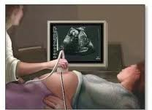
Measuring Fetal Growth With Ultrasound
Inexpensive, non-invasive ‘gold
standard’ of growth assessment
Fetal growth assessed by
changes in anatomical parameters:
Head circumference (HC), head size
abdominal circumference (AC), trunk size/liver development
femur length (FL), overall length
biparietal diameter (BPD), also measures head size
Parameter selection:
Reliable, well defined, easily measured, and insensitive to technical error. (Carrera et al. 2001)
Notes:
So why ultrasound measurements?
They are relatively inexpensive and not invasive and considered the gold standard of growth assessment.
Four anatomical parameters are commonly used in clinical settings, the head circumference, abdominal circumference, which is a proxy of organ volume and development, femur length and a second measure of head size, biparietal diameter
Although there are others, these are considered to be the most reliable a least sensitive to technical error.

Slide 10
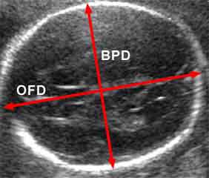
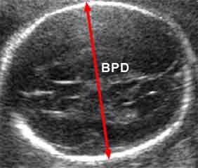
Ultrasound Parameters
Head Circumference
Biparietal Diameter
Not commonly stalled in size or reduced in growth rate ( brain sparing)
Reduction in size and growth rate could indicate decrease blood flow to fetus (Kingdom and Baker, 2000)
Subject to less measurement error. (Carrera et al, 2001)
Not a good single parameter predictor of IUGR late in gestation (Carrera et al, 2001)
(Images from: Snijders & Nicolaides, 1994)
Notes:
I include these next two slides as way to demonstrate how these anthropometric measurements are captured by ultrasound.
And to reiterate reasons that these parameters are used to identify fetal growth restriction.

Slide 11
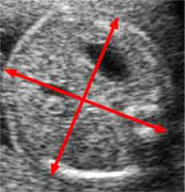
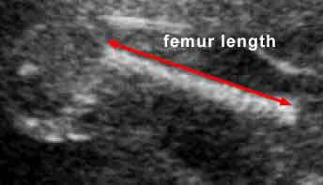
Ultrasound Parameters
Abdominal Circumference
Femur Length
Best single parameter indicator of fetal growth ≥ 32 weeks:
sensitivity=83%
specificity = 87.7%
Reflects volume of an incomplete liver development (Carrera et al, 2001)
Reductions may indicate symmetrical IUGR (Carrera et al, 2001)
FL/AC ratio can predict growth, independent of gestational age
(Images from: Snijders & Nicolaides, 1994)
Notes:
And here we see the Abdominal circumference which is a good single predictor of IUGR in late gestation and femur length which can predict growth independent of gestational age.

Slide 12
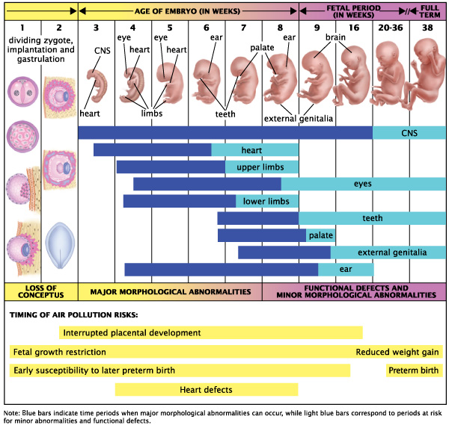
Notes:
We know that specific changes occur to a woman during pregnancy which may make her more susceptible to environmental exposures. One change in particular is the increase in alveolar uptake by roughly 50% , in order to transport more oxygen to the developing fetus. However, it is this very reason that may explain increased exposure to ambient air pollution during pregnancy.
Previous studies have suggested that early exposures to air pollutants may affect fetal growth at later periods and that these effects may vary depending on the anatomical parameter of interest.
We therefore, performed a longitudinal analysis to examine the association between increased maternal first trimester exposures to pollutants and predictions of attained size of fetal parameters during gestation.

Slide 13
Research questions
Is better maternal diet quality during pregnancy associated with greater fetal growth as measured by ultrasound?
Is maternal weight gain a mediator of this association?
Does the association between maternal diet quality during pregnancy and fetal growth depend on the mother’s pre-gestational body mass index (BMI)?

Slide 14
Research Importance & Implications
Use of repeated ultrasound measurements of fetal anthropometric parameters may reduce misclassification of growth restriction compared to SGA measure
Better understanding of extrinsic risk factors of IUGR (e.g., nutrition) could help with education around maternal health behaviors
Early identification of IUGR could set the course for treatment and management, reducing the number of IUGR attributed still births and low birth weight infants
Notes:
So what does this mean in terms of epidemiological studies of air pollution and fetal growth?
Hopefully, these results in addition to the 7 studies that previously performed similar analyses, will promote the use of ultrasound measurements in future studies of fetal growth, which could potentially reduce misclassification of IUGR compared to the use of SGA at birth.
Also by understanding the effects of air pollutants on individual fetal parameters, we may be closer to understanding the biological mechanisms explaining maternal exposure to air pollution and adverse pregnancy outcomes.
Clinically, the introduction of repeated ultrasound exams during pregnancy could help improve early identification and management of IUGR cases

Slide 15

Study Population Pregnancy Research on Inflammation, Nutrition, & City Environment: Systematic Analyses (PRINCESA) Cohort Funded by NIEHS grants: ES016932 and ES 017022
Live and work in Mexico City
Age ≥ 18 years
Most were non-smokers and recruited
< 18 weeks of gestation
Singleton pregnancy
Other study design details in O’Neill et al., 2012
CURRENT SAMPLE: 660 women with live births
Notes:
Therefore, the data used in this epidemiological analysis was from an ongoing cohort study on environmental pollution and birth outcomes in mexico city. The target enrollment is 1000 mother-fetal pairs residing and working in Mexico City for their entire pregnancy recruited at less than 18 weeks of gestation.

Slide 16



Location: Valley of Mexico
Altitude: 2,240 meters
Population: 21 million
Notes:
So knowing all of this, what better place to host a study of air pollution and IUGR than Mexico City, where air the improvement of air quality is a major public health concern.
Located in the valley of Mexico, at high altitude, Mexico City is home to an estimated 21 million people, 4 million vehicles operated in daily traffic and over 50,000 industries also contributing to ambient air pollution.
With the sub-tropical climate of this region, Mexico City residents are no strangers to temperature inversions trapping the air pollution over the city, thereby trapping pollutants and often resulting in intense smog, which can be seen in this aerial view of Mexico City.

Slide 17
Flow of data collection
Baseline:
Informed consent
Demographics
Health history
Monthly visits:
Clinical evaluation: fetal growth assessment with ultrasound, other clinical data.
Maternal anthropometric measures, weight gain
Nutritional assessment: Food frequency questionnaire (FFQ) and 24 hour recall.

Slide 18

Dietary intake
At one to three visits during pregnancy, we administered a quantitative assessment of dietary intake
Multi-step 24-hour dietary recall → quantitative
Use of food replicas
Analyzed by Food Processor®
Calculated:
Maternal Dietary Quality
Score (0 to 6, from food groups)
over the entire pregnancy

Slide 19
Variables of interest from Mexico City PRINCESA cohort
Repeated Fetal Ultrasound Data
Head Circumference (HC)
Biparietal Diameter (BPD)
Maternal Questionnaire Data
Maternal age
Total energy intake
Abdominal Circumference (AC)
Femur Length (FL)
Parity
Pre-pregnancy BMI
Nutrition (MDQS)
Education
Maternal weight gain (repeated measures)
Marital status
Maternal height
Baby’s sex
Notes:
So in terms of methodology, fetal ultrasound data and maternal data from questionnaires were collected at each visit which occurred at an approximate monthly basis.
As for the air pollution data, it was Collected by a government atmospheric monitoring system in Mexico City (SIMAT)
There are a total of 37 monitoring sites, collecting data for 6 criteria pollutants. Each monitor does not collect data for each pollutant as you can see by the distribution in the parentheses.
Data is reported as hourly concentrations for each day.

Slide 20


THANK YOU!
marieo@umich.edu

